Slide 1
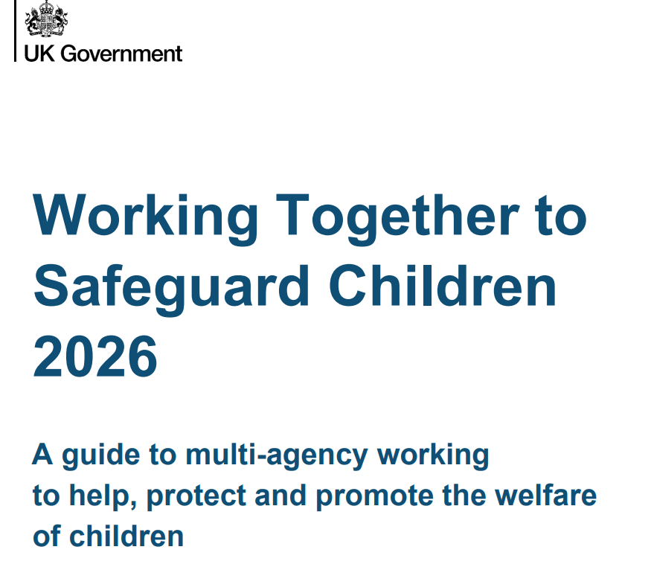
Working Together to Safeguard Children 2026 – Key Updates
Safeguarding is a shared, child-centred responsibility across all services.
Stronger collaboration = better outcomes for children.

Slide 2
2. Multi-Agency Working
Clearer roles of safeguarding partners
Stronger governance and accountability
Better alignment between local and national expectations
1. Shared responsibility
Safeguarding is everyone’s responsibility
3.Help & Support
One continuous journey (Early Help → Statutory Support)
Focus on early intervention
Right support at the right time
Greater multi-agency collaboration
Clear focus on the child’s voice and lived experience

Slide 3

4. Learning from serious incidents
Learning must lead to real change in practice
5. Child Death Reviews
Clearer processes
6. Decision Making
Based on the child’s journey
Stronger links between local and national reviews
Integrated into wider safeguarding systems
Focus on accountability and learning
Clearer thresholds for action
Promotes consistent and timely responses
Policy will be uploaded to the CPOMS library and you will receive an alert

